Slide 1
Unit -2
Process Management
Presentation By
Prof. A. R. Jadhav

Slide 2
Process Concept
Process – a program in execution; process execution must progress in a sequential fashion
An operating system executes a variety of programs:
  Batch system – jobs
  Time-shared systems – user programs or tasks
Multiple parts
  The program code, also called the text section
  Current activity including program counter, processor registers
  Stack containing temporary data

Slide 3

Process in Memory

Slide 4
…contd.
Function parameters, return addresses, local variables
Data section containing global variables
Heap containing memory dynamically allocated during run time
Program is a passive entity stored on disk (executable file), the process is active
Program becomes process when executable file loaded into memory

Slide 5
Execution of program started via GUI mouse clicks, command line entry of its name, etc
One program can be several processes
  Consider multiple users executing the same program

Slide 6
Process State
As a process executes, it changes state
  new: The process is being created
  running: Instructions are being executed
  waiting: The process is waiting for some event to occur
  ready: The process is waiting to be assigned to a processor
  terminated: The process has finished execution

Slide 7

Process State Diagram

Slide 8

Process Control Block (PCB)
Information associated with each process
(also called task control block)
Process state – running, waiting, etc.
Program counter – location of instruction to next execute
CPU registers – contents of all process-centric registers
CPU scheduling information- priorities, scheduling queue pointers
Memory-management information – memory allocated to the process
Accounting information – CPU used, clock time elapsed since start, time limits
I/O status information – I/O devices allocated to the process, list of open files

Slide 9

CPU Switch From Process to Process

Slide 10
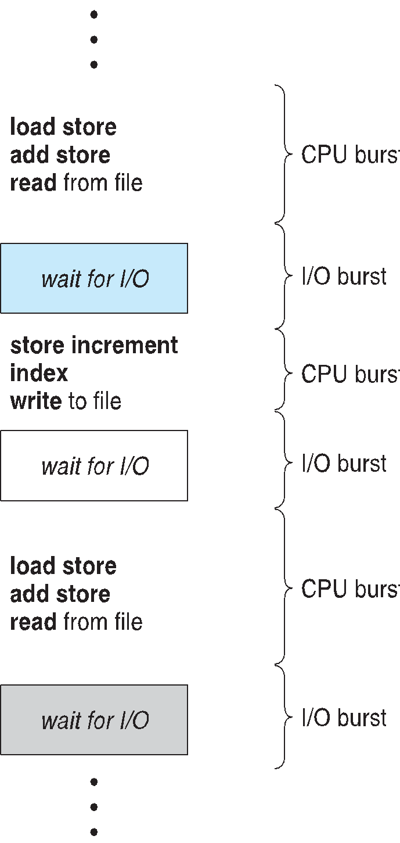
CPU Scheduling
Maximum CPU utilization obtained with multiprogramming
CPU–I/O Burst Cycle – Process execution consists of a cycle of CPU execution and I/O wait
CPU burst followed by I/O burst

Slide 11
CPU Scheduler
Short-term scheduler selects from among the processes in the ready queue, and allocates the CPU to one of them
CPU scheduling decisions may take place when a process:
1. Switches from running to waiting state
2. Switches from running to ready state
3. Switches from waiting to ready
4. Terminates
Scheduling under 1 and 4 is non-preemptive
All other scheduling is preemptive
Consider access to shared data
Consider non-preemption while in kernel mode
Consider interrupts occurring during crucial OS activities

Slide 12
Scheduling Criteria
CPU utilization – keep the CPU as busy as possible
Throughput – No. of processes that complete their execution per time unit
Turnaround time – the amount of time to execute a particular process
Waiting time – the amount of time a process has been waiting in the ready queue
Response time – amount of time it takes from when a request was submitted until the first response is produced, not output (for the time-sharing environment)

Slide 13
Scheduling Algorithm Optimization Criteria
Max CPU utilization
Max throughput
Min turnaround time
Min waiting time
Min response time

Slide 14
First come first serve - FCFS
Process Burst Time
P₁ 24
P₂ 3
P₃ 3
Suppose that the processes arrive in the order: P₁, P₂ , P₃
The Gantt Chart for the schedule is:
0 24 27 30
Waiting time for P₁ = 0; P₂ = 24; P₃ = 27
Average waiting time: (0 + 24 + 27)/3 = 17
P1 | P2 | P3

Slide 15
Contd..
Suppose that the processes arrive in the order:
P₂ , P₃ , P₁
The Gantt chart for the schedule is:
P1 0 3 6 30
Waiting time for P₁ = 6; P₂ = 0; P₃ = 3
Average waiting time: (6 + 0 + 3)/3 = 3
Much better than the previous case
Convoy effect - short process behind long process
P2 | P3 | P1

Slide 16
IPC

Slide 17
Interprocess Communication
Processes within a system may be independent or cooperating
Cooperating process can affect or be affected by other processes, including sharing data
Cooperating processes need interprocess communication (IPC)
Advantages of process cooperation
  Information sharing
  Computation speed-up
  Modularity
  Convenience

Slide 18
Two models of IPC
  Shared memory
  Message Passing

Slide 19
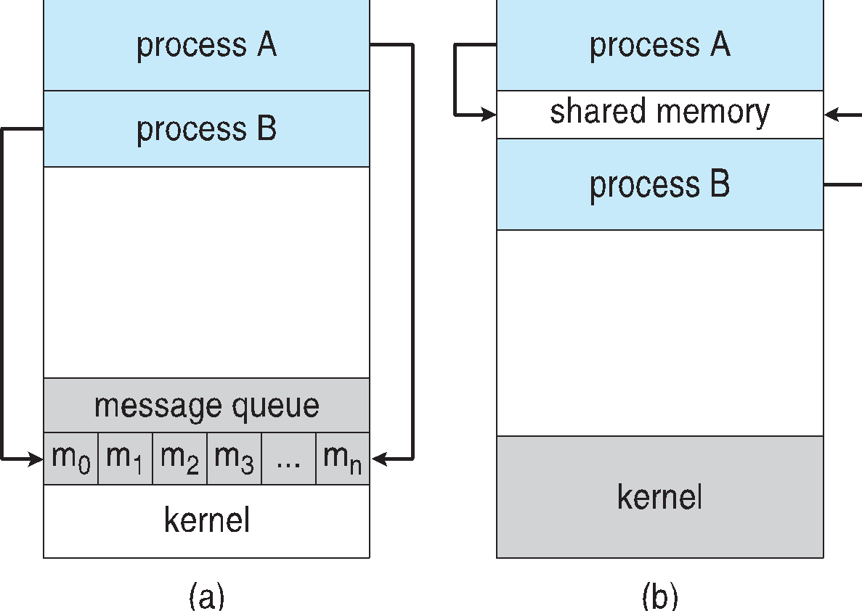
Communications Models
(a) Message passing. (b) shared memory.

Slide 20
Shared Memory
Producer–Consumer Problem
Bounded Buffer
Unbounded Buffer

Slide 21
Message Passing
Mechanism for processes to communicate and to synchronize their actions
Message system – processes communicate with each other without resorting to shared variables
IPC facility provides two operations:
  send(message)
  receive(message)
The message size is either fixed or variable

Slide 22
Message passing contd…
If processes P and Q wish to communicate, they need to:
  Establish a communication link between them
  Exchange messages via send/receive

Slide 23
…contd.
Implementation issues:
  How are links established?
  Can a link be associated with more than two processes?
  How many links can there be between every pair of communicating processes?
  What is the capacity of a link?
  Is the size of a message that the link can accommodate fixed or variable?
  Is a link unidirectional or bi-directional?

Slide 24
Buffering
Queue of messages attached to the link.
Implemented in one of three ways
1. Zero capacity – no messages are queued on a link.
The sender must wait for the receiver
2. Bounded capacity – finite length of n messages
The sender must wait if the link full
3. Unbounded capacity – infinite length
Sender never waits

Slide 25
Message passing contd…
Implementation of a communication link
  Physical:
    Shared memory
    Hardware bus
    Network
  Logical:
    Direct or indirect
    Synchronous or asynchronous

Slide 26
Direct Communication
Processes must name each other explicitly:
  send (P, message) – send a message to process P
  receive(Q, message) – receive a message from process Q
Properties of communication link
  Links are established automatically
  A link is associated with exactly one pair of communicating processes
  Between each pair there exists exactly one link
  The link may be unidirectional but is usually bi-directional

Slide 27
Indirect Communication
Messages are directed and received from mailboxes (also referred to as ports)
  Each mailbox has a unique id
  Processes can communicate only if they share a mailbox
Properties of communication link
  Link established only if processes share a common mailbox
  A link may be associated with many processes
  Each pair of processes may share several communication links
  Link may be unidirectional or bi-directional

Slide 28
Indirect Communication
Operations
  create a new mailbox (port)
  send and receive messages through the mailbox
  Destroy the connection link
Primitives are defined as:
send(A, message) – send a message to mailbox A
receive(A, message) – receive a message from mailbox A

Slide 29
Indirect Communication
Mailbox sharing
  P₁, P₂, and P₃ share mailbox A
  P₁, sends; P₂ and P₃ receive
  Who gets the message?
Solutions
  Allow a link to be associated with at most two processes
  Allow only one process at a time to execute a receive operation
  Allow the system to select arbitrarily the receiver. The sender is notified of who the receiver was.

Slide 30
Synchronization
Message passing may be either blocking or non-blocking
Blocking is considered synchronous
  Blocking send -- the sender is blocked until the message is received
  Blocking receive -- the receiver is blocked until a message is available
Non-blocking is considered asynchronous
  Non-blocking send -- the sender sends the message and continue
  Non-blocking receive -- the receiver receives:
    A valid or Invalid message,
    Null message
Different combinations possible
  If both send and receive are blocking, we have a rendezvous

Slide 31
Threads
Most modern applications are multithreaded
Threads run within application
Multiple tasks with the application can be implemented by separate threads
  - Update display
  - Fetch data
  - Spell checking
  - Answer a network request
Process creation is heavy-weight while thread creation is light-weight
Can simplify code, increase efficiency
Kernels are generally multithreaded

Slide 32
Benefits
Responsiveness – may allow continued execution if part of the process is blocked, especially important for user interfaces
Resource Sharing – threads share resources of process, easier than shared memory or message passing
Economy – cheaper than process creation, thread switching lower overhead than context switching
Scalability – process can take advantage of multiprocessor architectures

Slide 33
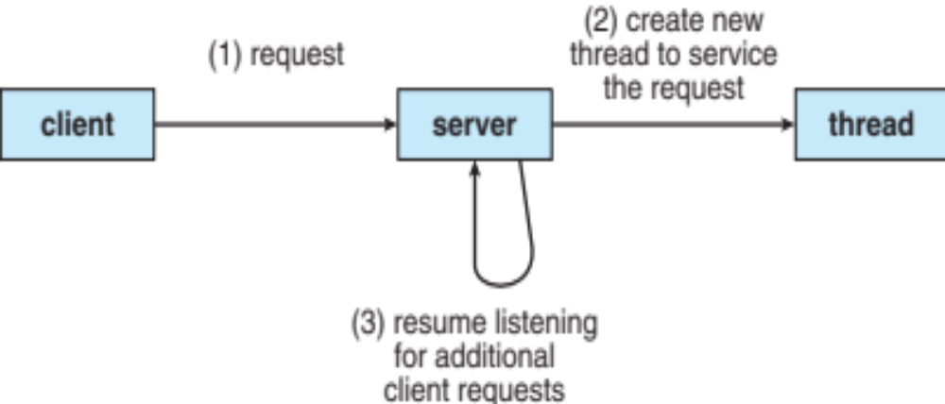
Multithreaded Server Architecture

Slide 34
Multicore Programming
Multicore or multiprocessor systems putting pressure on programmers,
challenges include:
  Dividing activities
  Balance
  Data splitting
  Data dependency
  Testing and debugging
Parallelism implies a system can perform more than one task simultaneously
Concurrency supports more than one task making progress

Slide 35
Multicore contd.
Types of parallelism -
  Data parallelism – distributes subsets of the same data across multiple cores, same operation on each
  Task parallelism – distributing threads across cores, each thread performing unique operation

Slide 36


Concurrency vs. Parallelism
Concurrent execution on single-core system:
Parallelism on a multi-core system:

Slide 37

Single and Multithreaded Processes

Slide 38
Multithreading Models
Many-to-One
One-to-One
Many-to-Many

Slide 39

Many-to-One
Many user-level threads mapped to a single kernel thread
One thread blocking causes all to block
Multiple threads may not run in parallel on multicore system because only one may be in the kernel at a time
Few systems currently use this model
Examples: Solaris Green Threads
  GNU Portable Threads

Slide 40

One-to-One
Each user-level thread maps to the kernel thread
Creating a user-level thread creates a kernel thread
More concurrency than many-to-one
The number of threads per process is sometimes restricted due to overhead
Examples: Windows, Linux, Solaris 9

Slide 41

Many-to-Many Model
Allows many user-level threads to be mapped to many kernel threads
Allows the operating system to create a sufficient number of kernel threads
Ex: Solaris prior to version 9, Windows with the ThreadFiber package

Slide 42

Two-level Model
Similar to M:M, except that it allows a user thread to be bound to kernel thread
Examples
  IRIX
  HP-UX
  Tru64 UNIX
  Solaris 8 and earlier

Slide 43
Implicit Threading
Growing in popularity as numbers of threads increase, program correctness is more difficult with explicit threads
Creation and management of threads are done by compilers and run-time libraries rather than programmers
Methods explored
  Thread Pools
  OpenMP
  Grand Central Dispatch

Slide 44

Thread Pools
Create a number of threads in a pool where they await work
Advantages:
  Usually slightly faster to service a request with an existing thread than create a new thread
  Allows the number of threads in the application(s) to be bound to the size of the pool
  Tasks could be scheduled to run periodically
Windows API supports thread pools:

Slide 45

OpenMP
Set of compiler directives and an API for C, C++, FORTRAN
Provides support for parallel programming in shared-memory environments
Identifies parallel regions – blocks of code that can run in parallel
#pragma omp parallel
Create as many threads as there are cores
#pragma omp parallel for for(i=0;i<N;i++) {
c[i] = a[i] + b[i];
}
Run for loop in parallel

Slide 46
Grand Central Dispatch
Apple technology for Mac OS X and iOS operating systems
Extensions to C, C++ languages, API, and run-time library
Allows identification of parallel sections
Manages most of the details of threading
Block is in “^{ }” - ˆ{ printf("I am a block"); }
Blocks placed in dispatch queue
  Assigned to available thread in thread pool when removed from queue

Slide 47
Grand Central Dispatch
Two types of dispatch queues:
  serial – blocks removed in FIFO order, a queue is per process, called the main queue
    Programmers can create additional serial queues within the program
  concurrent – removed in FIFO order but several may be removed at a time
    Three system-wide queues with priorities low, default, and high

Slide 48
Threading Issues
Semantics of fork() and exec() system calls
Signal handling
  Synchronous and asynchronous
Thread cancellation of the target thread
  Asynchronous or deferred
Thread-local storage
Scheduler Activations

Slide 49
Semantics of fork() and exec()
Does fork()duplicate only the calling thread or all threads?
  Some UNIXs have two versions of fork
exec() usually works as normal – replace the running process including all threads

Slide 50
Signal Handling
Signals are used in UNIX systems to notify a process that a particular event has occurred.
A signal handler is used to process signals
  Signal is generated by a particular event
  Signal is delivered to a process
  Signal is handled by one of two signal handlers:
    default
    user-defined
Every signal has a default handler that the kernel runs when handling the signal
  The user-defined signal handler can override the default
  For single-threaded, signal delivered to process

Slide 51
Signal Handling (Cont.)
Where should a signal be delivered for multi-threaded?
  Deliver the signal to the thread to which the signal applies
  Deliver the signal to every thread in the process
  Deliver the signal to certain threads in the process
  Assign a specific thread to receive all signals for the process

Slide 52
Thread Cancellation
Terminating a thread before it has finished
Thread to be canceled is target thread
Two general approaches:
  Asynchronous cancellation terminates the target thread immediately
  Deferred cancellation allows the target thread to periodically check if it should be canceled

Slide 53

Thread Cancellation (Cont.)
Invoking thread cancellation requests cancellation, but actual cancellation depends on thread state
If thread has cancellation disabled, cancellation remains pending until thread enables it
Default type is deferred
  Cancellation only occurs when thread reaches cancellation point
    I.e. pthread_testcancel()
    Then cleanup handler is invoked
On Linux systems, thread cancellation is handled through signals

Slide 54
THANK YOU

